Slide 1
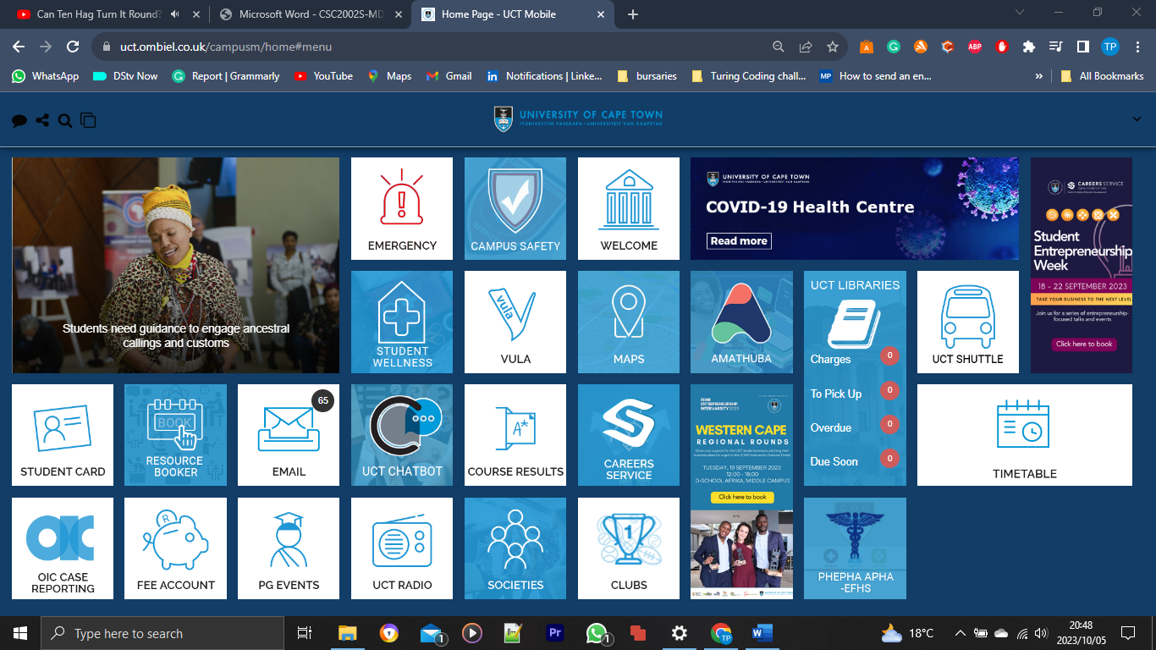


Campus loadshedding
Campus Nev

Slide 2

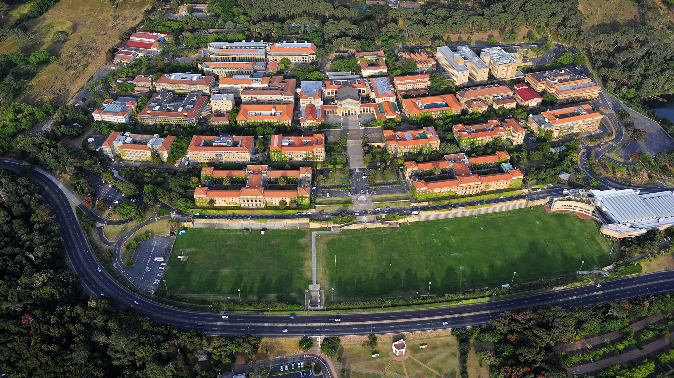
UCT NAVIGATION SYSTEM
UPPER CAMPUS
MIDDLE & LOWER CAMPUS
HEALTH SCIENCE CAMPUS
HIDDINGH CAMPUS
BREAK WATER CAMPUS

Slide 3

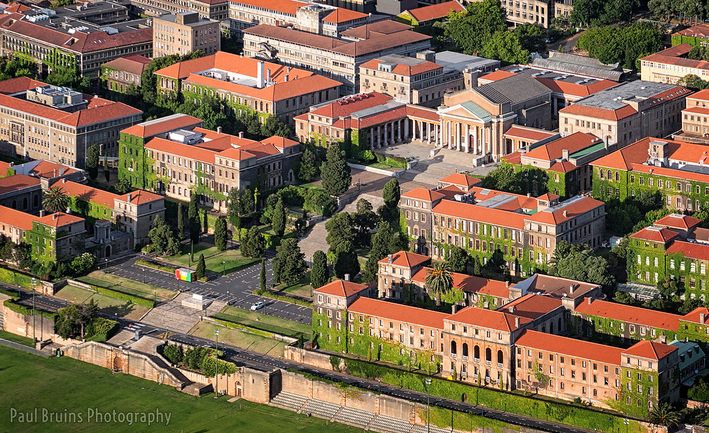
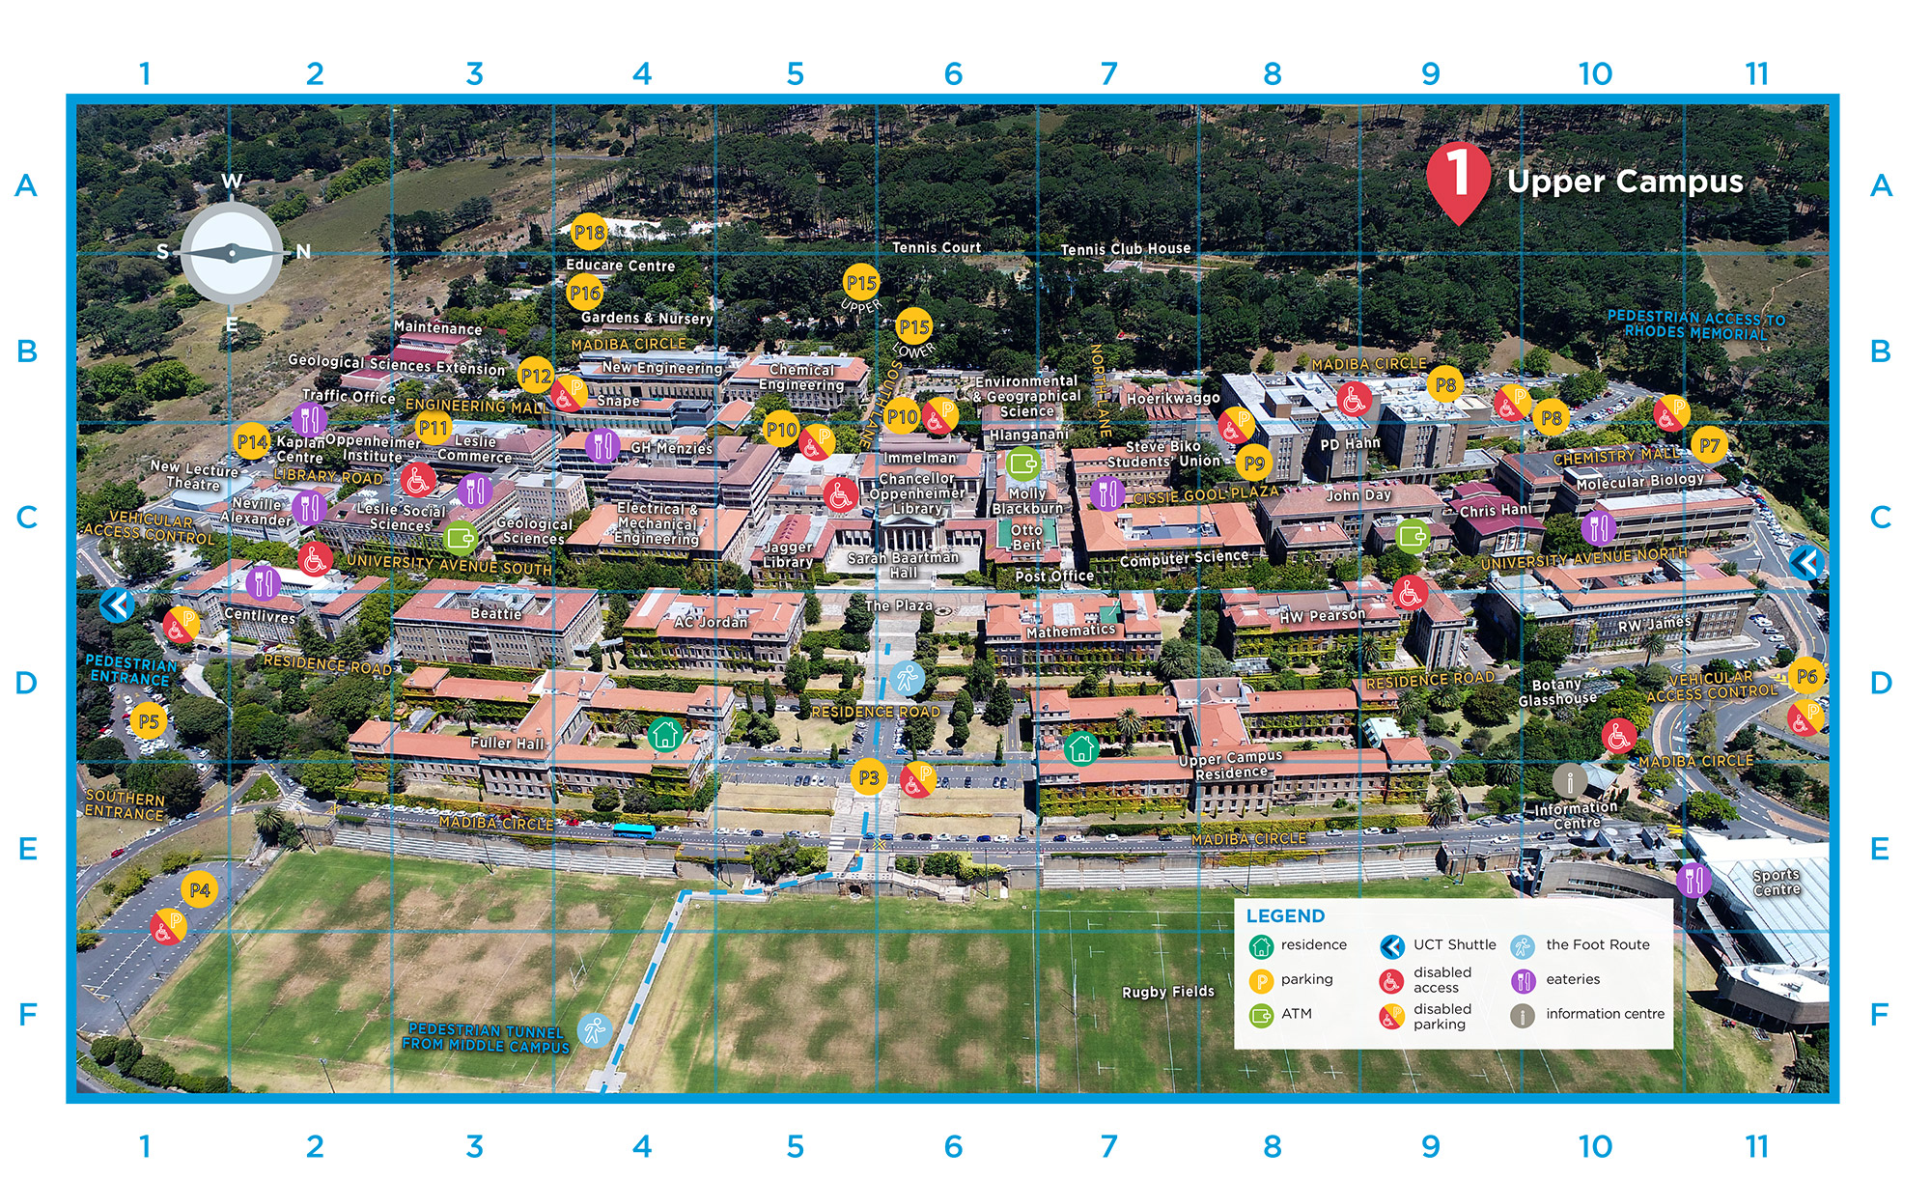
UPPER CAMPUS
PLEASE CLICK MAP & SELECT THE DESIRED BUILDING

Slide 4
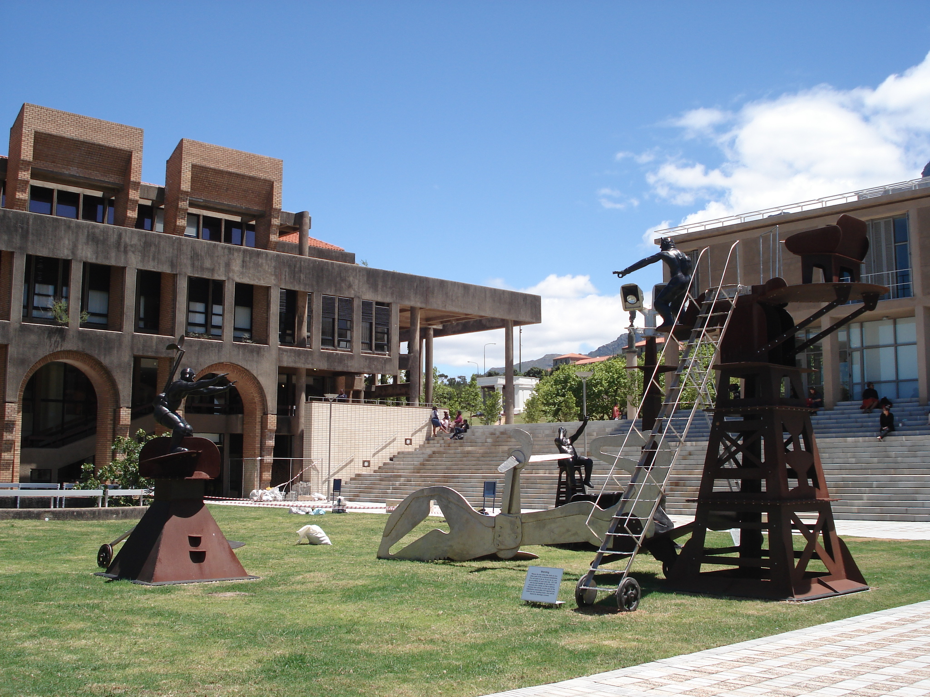
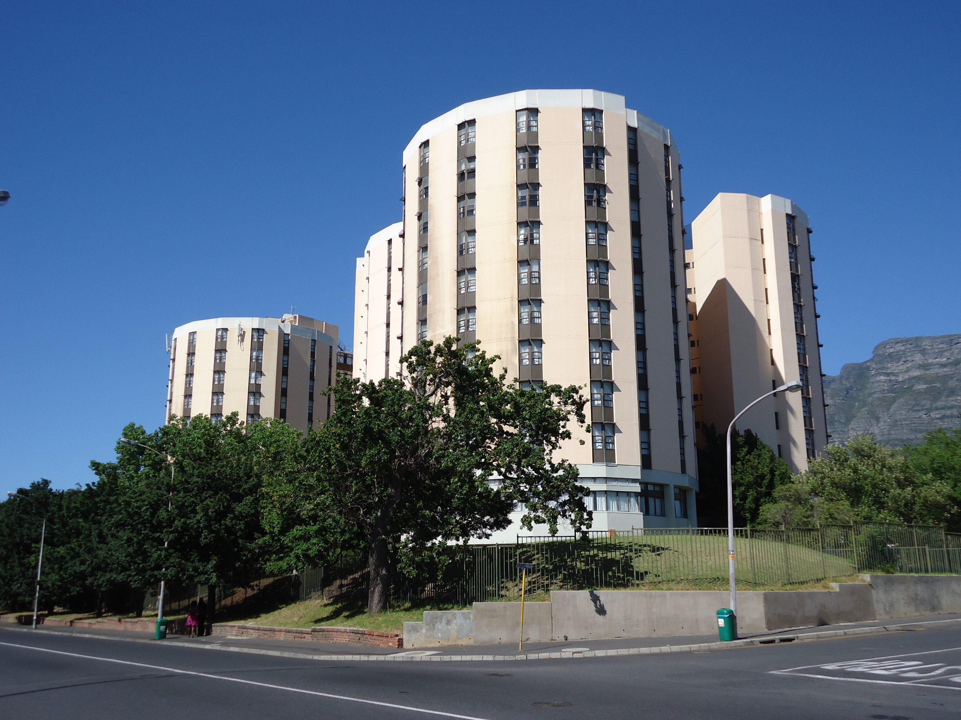
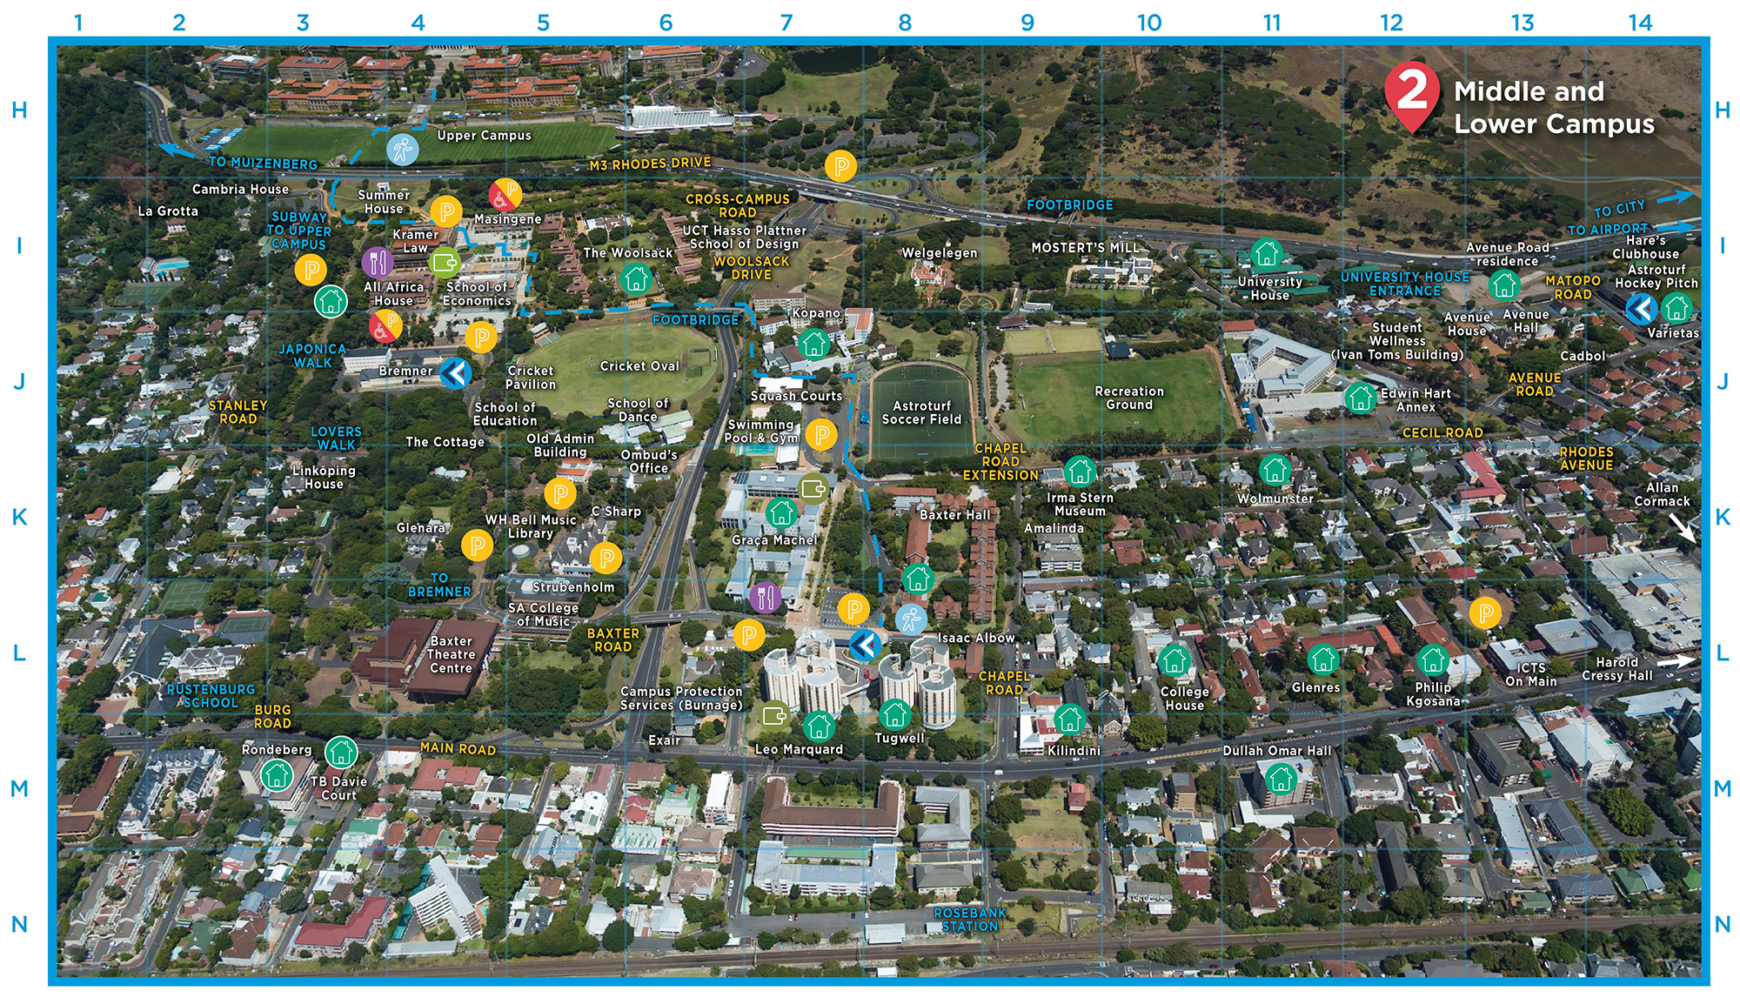
MIDDLE & LOWER CAMPUS
PLEASE CLICK MAP & SELECT THE DESIRED BUILDING

Slide 5
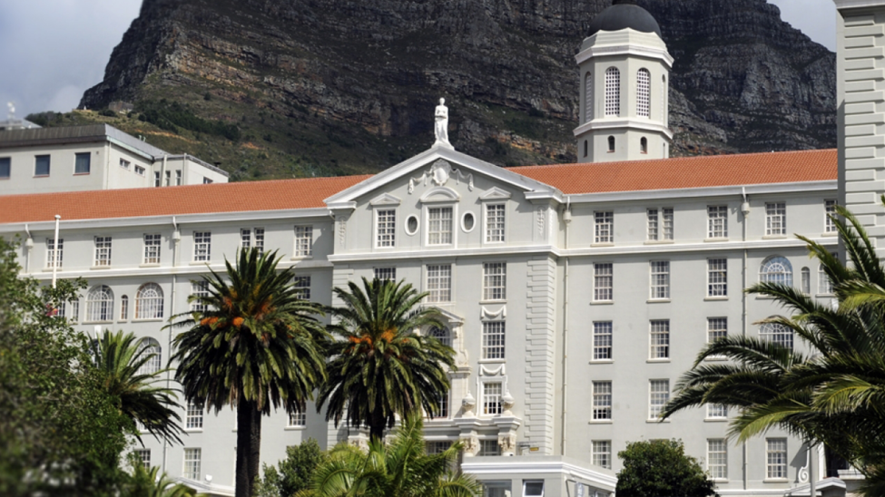
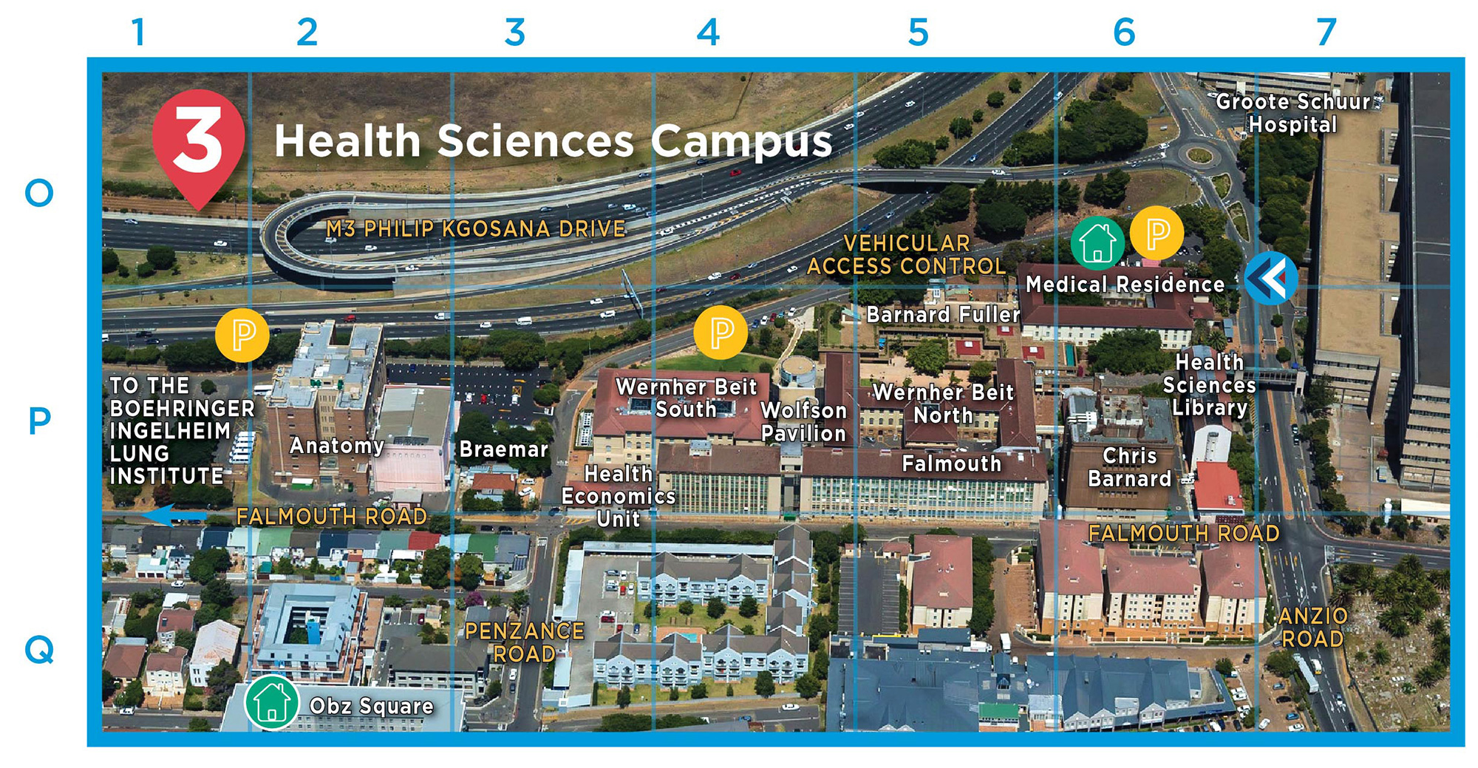
HEALTH SCIENCE CAMPUS
PLEASE CLICK MAP & SELECT THE DESIRED BUILDING

Slide 6
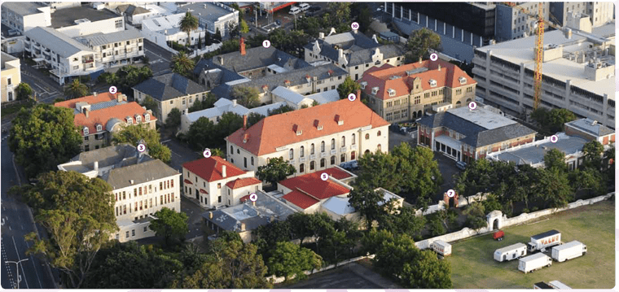
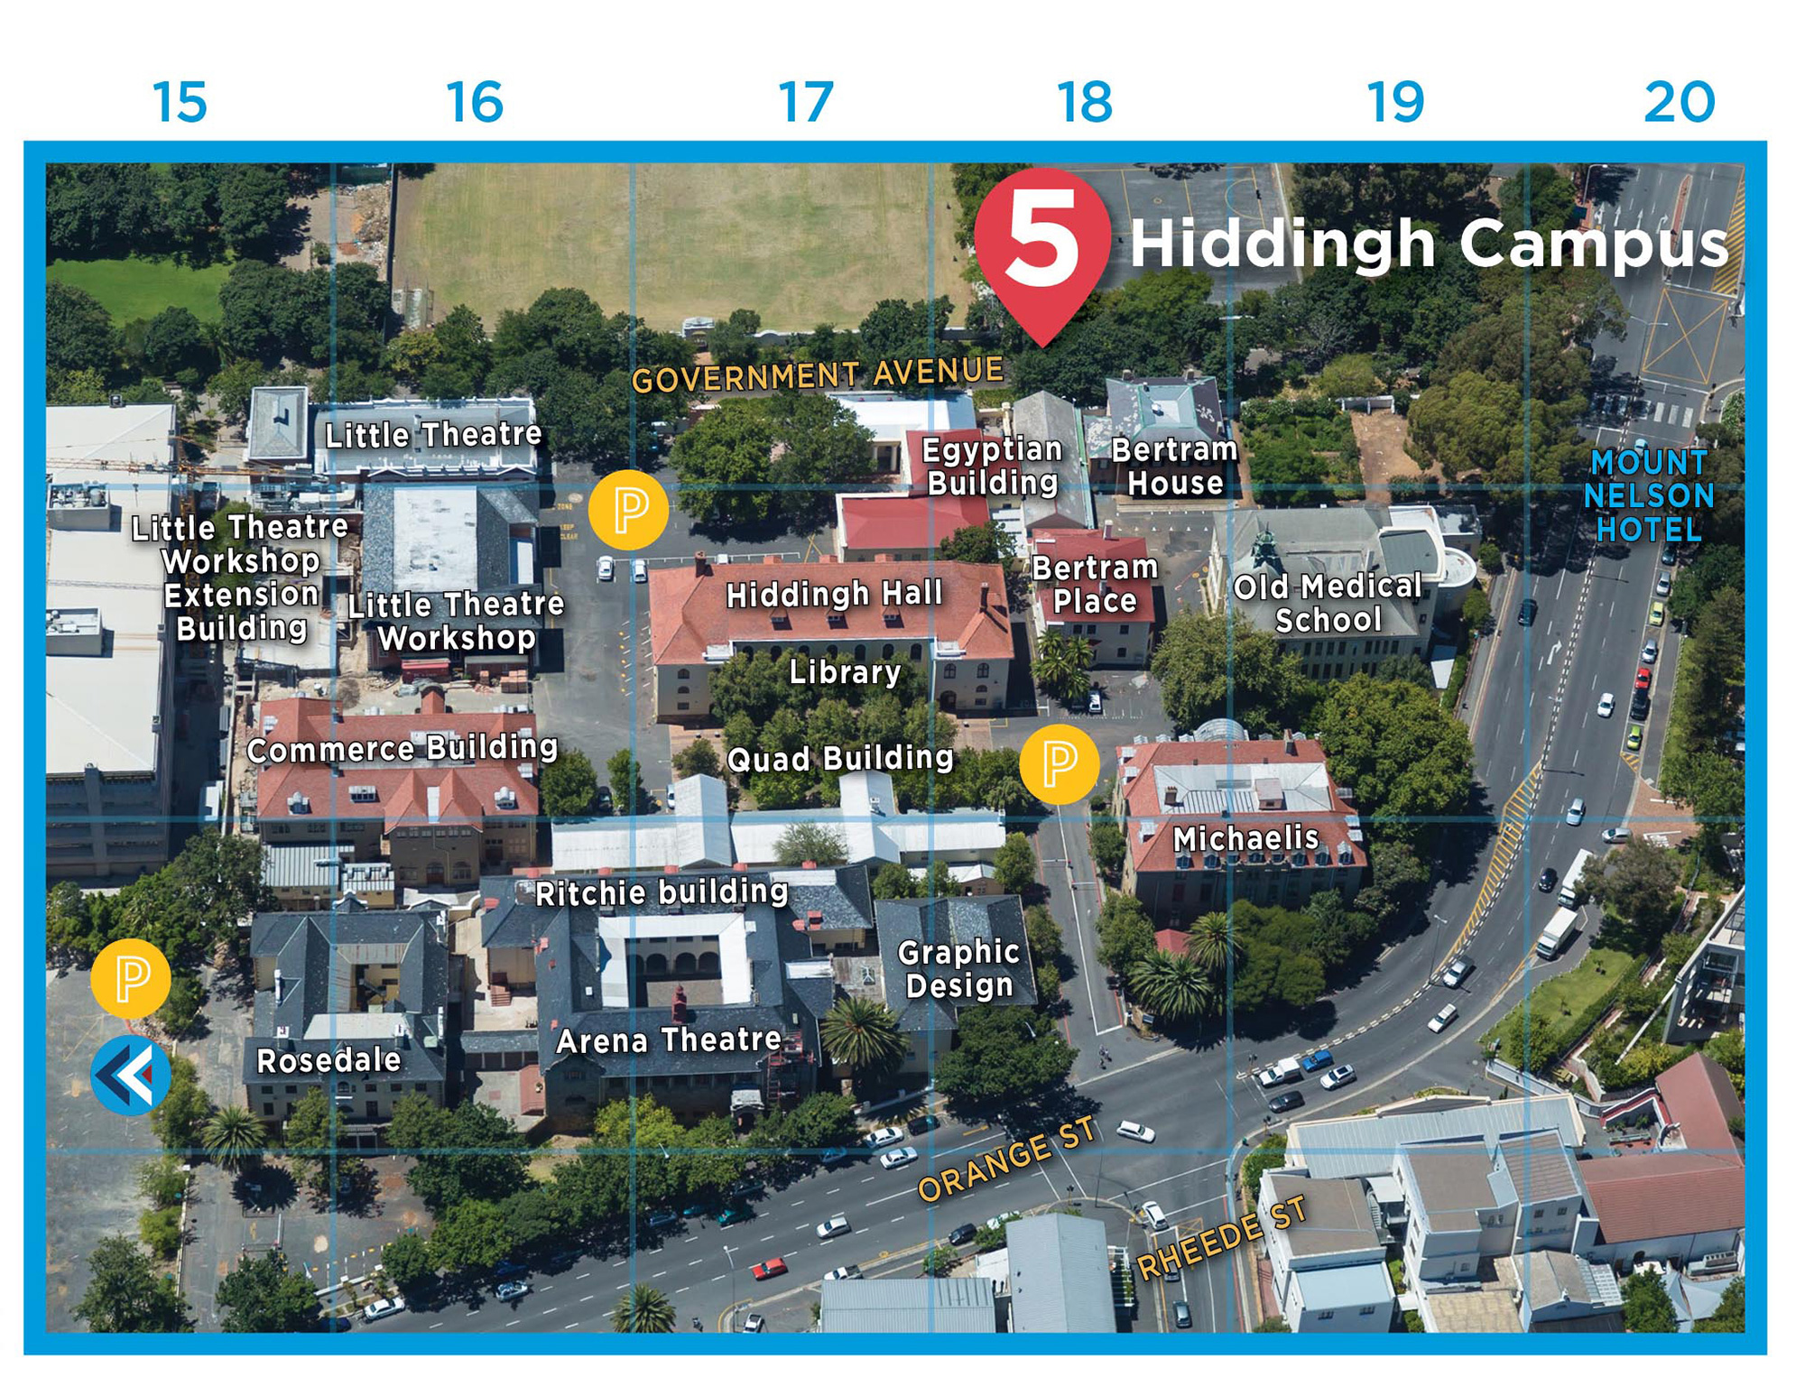
HIDDINGH CAMPUS
PLEASE CLICK MAP & SELECT THE DESIRED BUILDING

Slide 7
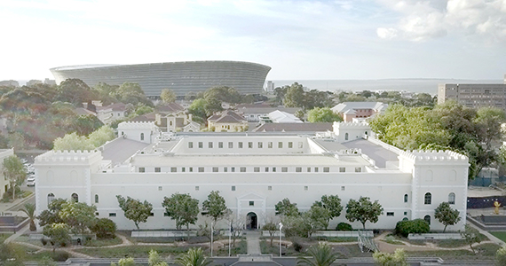
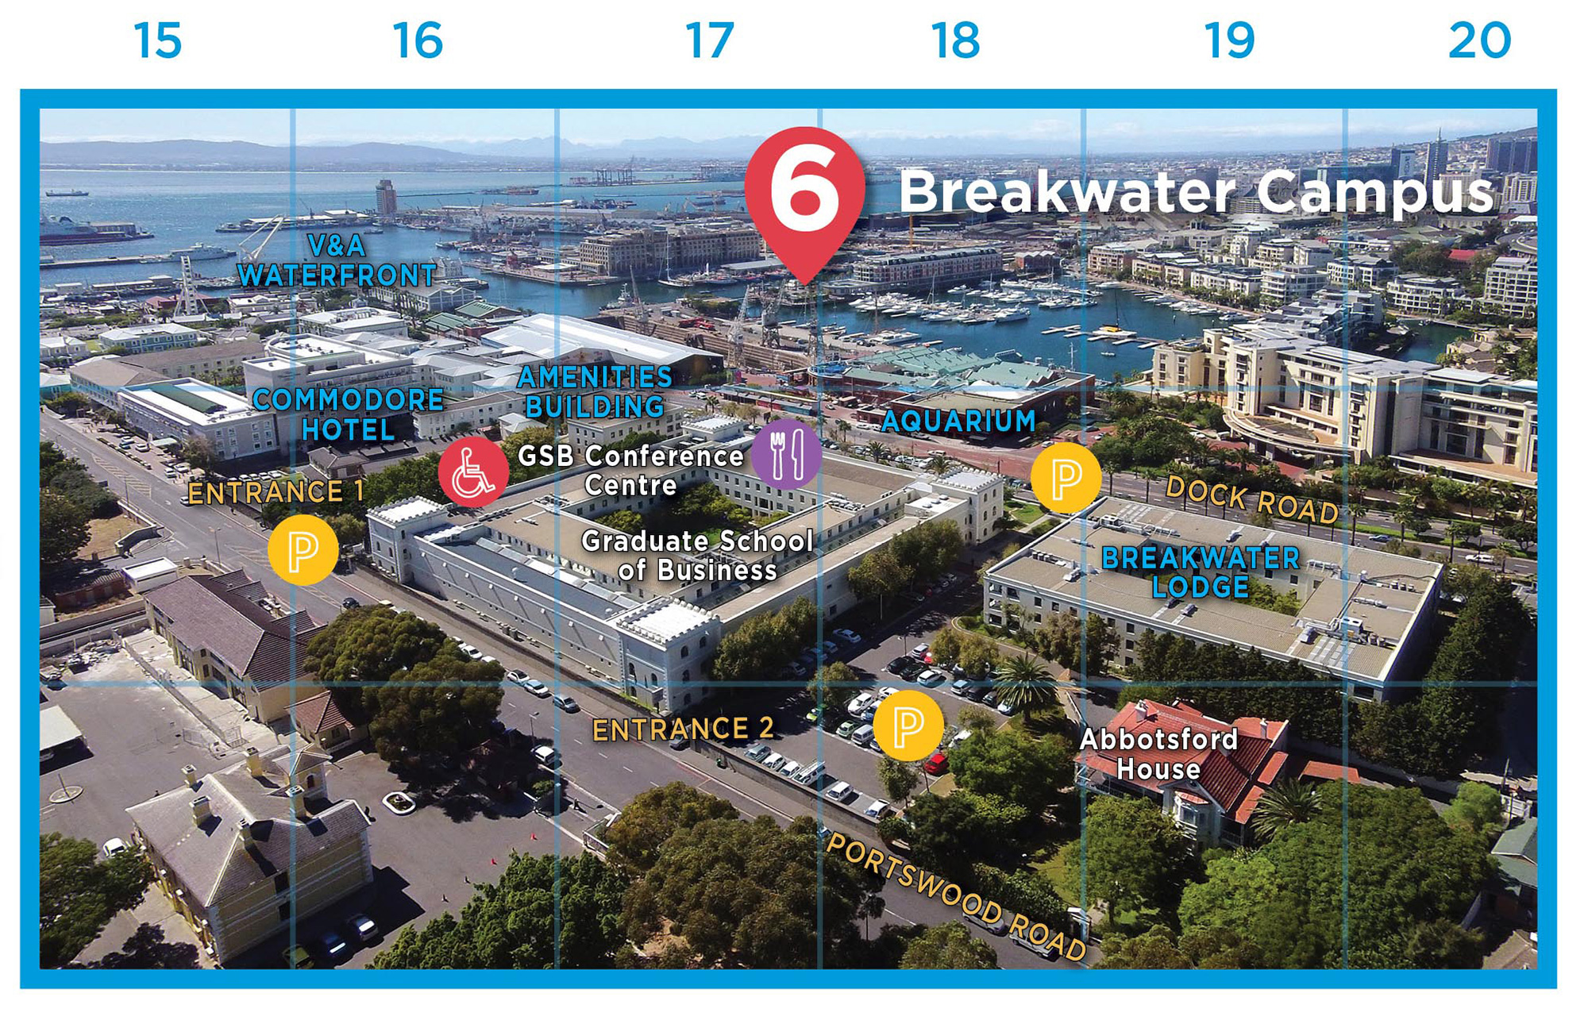
BREAKWATER CAMPUS
PLEASE CLICK MAP & SELECT THE DESIRED BUILDING

Slide 8
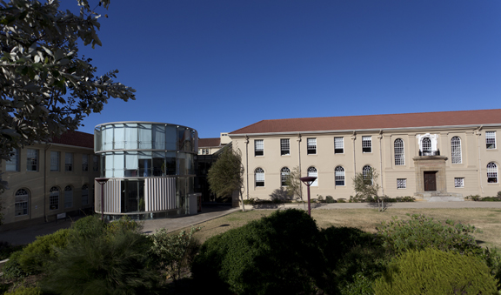
BEAT-THE-SHED
PLEASE SELECT AREA
ROSEBANK
OBSEVERTORY
GARDENS
BREAKWATER

Slide 9


BEAT-THE-SHED
ROSEBANK
CHECK SCHEDULE
LOAD SHEDDING FREE ZONES

Slide 10
BEAT-THE-SHED
GARDENS
CHECK SCHEDULE
LOAD SHEDDING FREE ZONES

Slide 11
BEAT-THE-SHED
OBSEVERTORY
CHECK SCHEDULE
LOAD SHEDDING FREE ZONES

Slide 12
BEAT-THE-SHED
BREAKWATER
CHECK SCHEDULE
LOAD SHEDDING FREE ZONES

